Slide 1
Metallic bond, this bond is found in metals and their alloys. Metallic materials have one, two, or at most, three valence electrons. With this model, these valence electrons are not bound to any particular atom in the solid and are more or less free to drift throughout the entire metal. They may be thought of as belonging to the metal as a whole, or forming a “sea of electrons” or an “electron cloud. The free electrons act as a “glue” to hold the ion cores together, this type of bond is shown in Figure 8. It is important to note that this type of bond has a general sharing of electrons and freedom to move within the material, these give the main properties of the metals and alloy which are ductility, thermal conductivity and electrical conductivity.

Slide 2
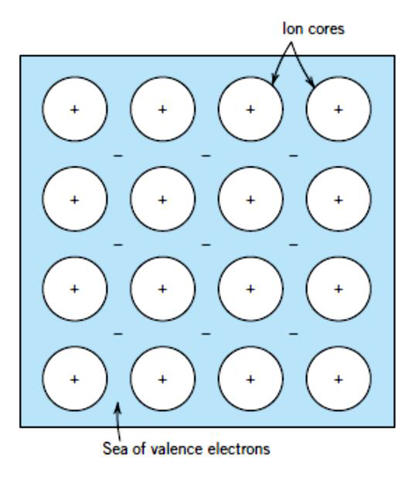
Figure (8) Schematic shows metallic bonding

Slide 3
The secondary bond is known as a van der Waals, or physical bonds that are weak in comparison to the primary or chemical ones, secondary bonding exists between practically all atoms or molecules. In materials some molecules might have a permanent polarisation of charge in this way with some parts with a net negative charge and some with a net positive charge, the molecules being then said to be dipoles. We can thus have electrostatic forces of attraction between such polarised atoms or molecules, this situation can be seen in Figure 9
Figure (9) Van der Waals bonding between two dipoles

Slide 4
2.3 Crystal structures
The arrangement of particles, i.e. atoms, ions and molecules, in solids determines the microstructure and is an important aspect in determine the properties. As an example, a change in microstructure can change a metal from being ductile to brittle.
Solid materials may be classified according to the regularity with which atoms or ions are arranged with respect to one another. A crystalline material is one in which the atoms are situated in a repeating or periodic array over large atomic distances; that is, long-range order exists, such that upon solidification, the atoms will position themselves in a repetitive three-dimensional pattern, in which each atom is bonded to its nearest-neighbour atoms. All metals, many ceramic materials, and certain polymers form crystalline structures under normal solidification conditions. For those that do not crystallize, this long-range atomic order is absent; these noncrystalline or amorphous materials are discussed briefly at the end of this chapter.

Slide 5
Some of the properties of crystalline solids depend on the crystal structure of the material, the manner in which atoms, ions, or molecules are spatially arranged. There is an extremely large number of different crystal structures all having long range atomic order; these vary from relatively simple structures for metals to exceedingly complex ones, as displayed by some of the ceramic and polymeric materials.

Slide 6
Important definition: “lattice” means a three-dimensional array of points coinciding with atom positions (or sphere centres). The atomic order in crystalline solids indicates that small groups of atoms form a repetitive pattern. Thus, in describing crystal structures, it is often convenient to subdivide the structure into small repeat entities called unit cells.
Generally speaking, three relatively simple crystal structures are found for most of the common metals face centred cubic, body-centred cubic, and hexagonal close-packed.

Slide 7
• The Face-Centred Cubic Crystal Structure
The crystal structure found for many metals has a unit cell of cubic geometry, with atoms located at each of the corners and the centres of all the cube faces. It is called the face-centred cubic (FCC) crystal structure. Some of the familiar metals having this crystal structure are copper, aluminium, silver, and gold (Table 1) Figure 10 shows a hard sphere model for the FCC unit cell, whereas in Figure 3.1b the atom centres are represented by small circles to provide a better perspective of atom positions. The aggregate of atoms in Figure 3.1c represents a section of crystal consisting of many FCC unit cells.

Slide 8
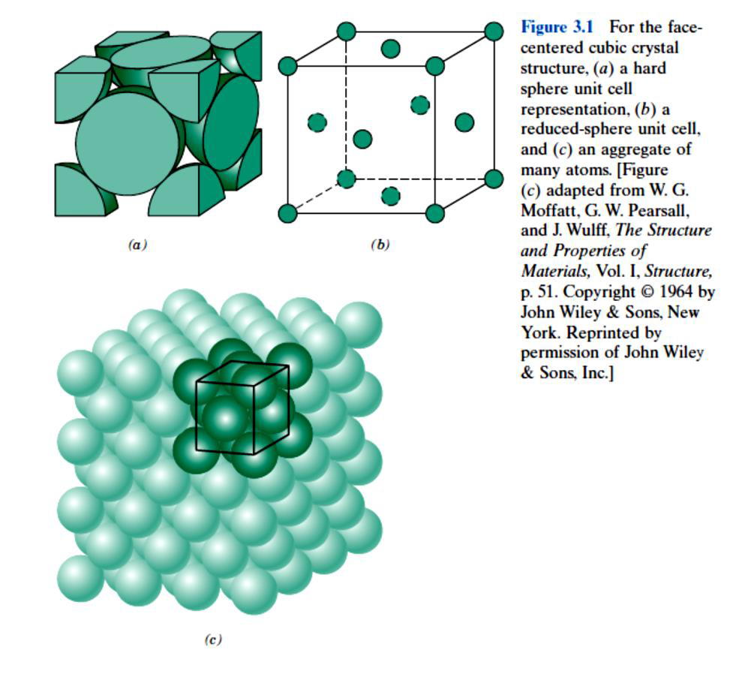
Figure 10 Face centred cubic crystal structure details are shown in graph ‘figure 3-1’

Slide 9
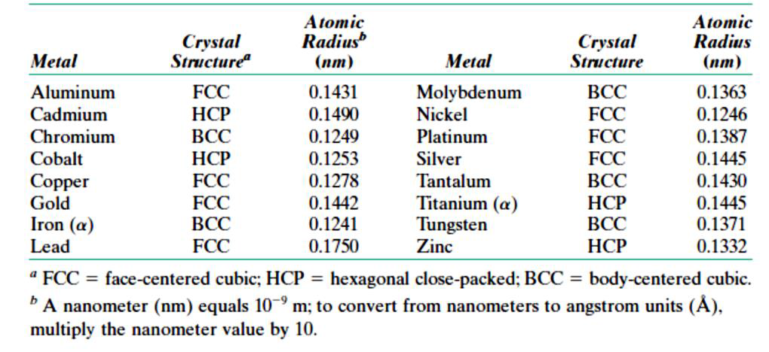
Table 1 Atomic radial crystal structure for 16 metals

